Slide 1
TIỂU LUẬN
TÌM HIỂU VỀ WEBRTC THÔNG QUA NODEJS VÀ SOCKET.IO

Slide 2
Contents
3
webRTC web
4
SOCKET.IO
5
NODEJS
6
Canvas In Javascript
7
STREAMING VIDEO
8
Github
9
Heroku server

Slide 3
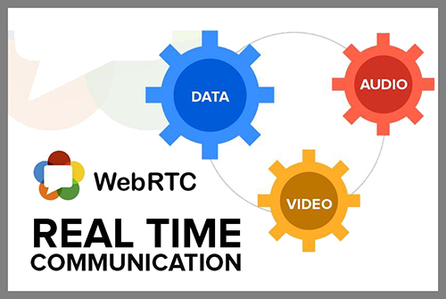
webRTC web

Slide 4
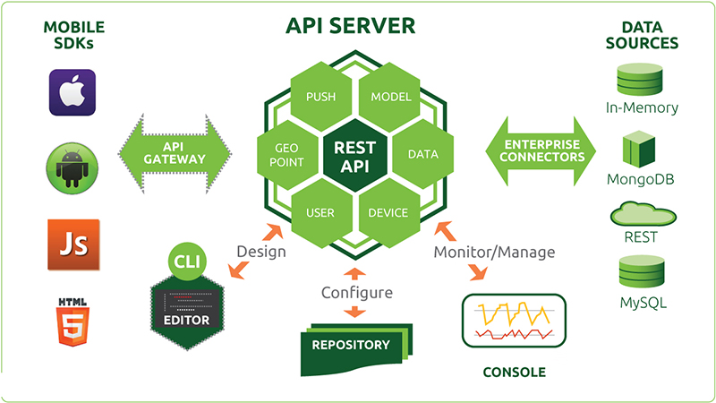
NODEJS

Slide 5
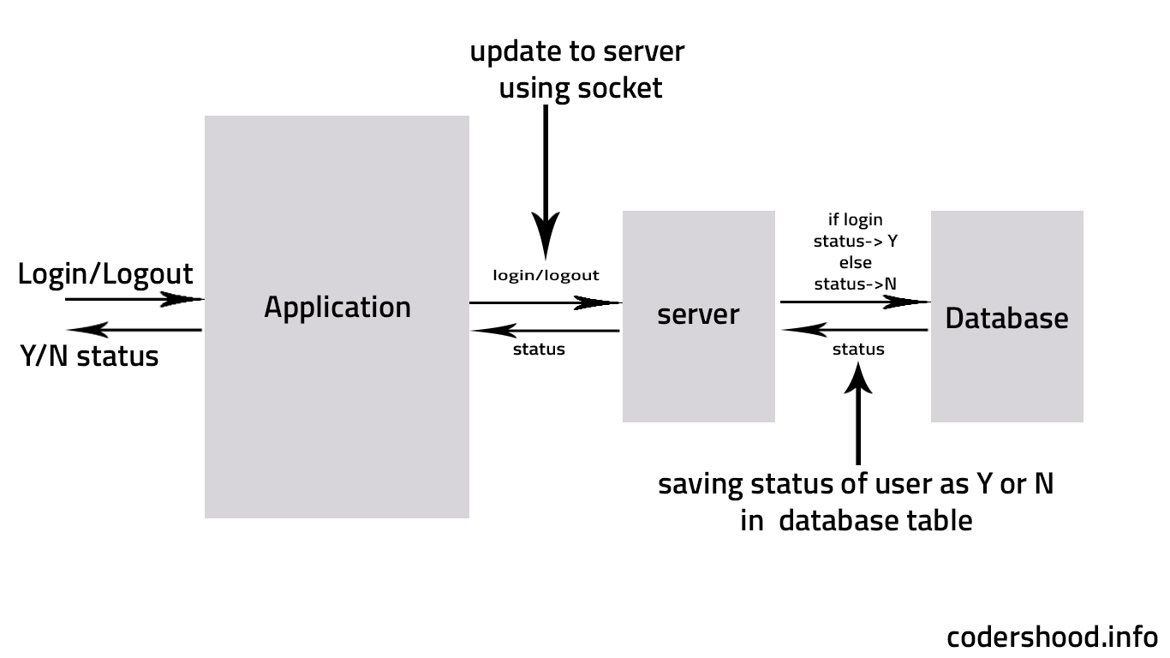
SOCKET.IO

Slide 6

Canvas In Javascript

Slide 7

STREAMING VIDEO
Text
Text
Txt
T
Text

Slide 8
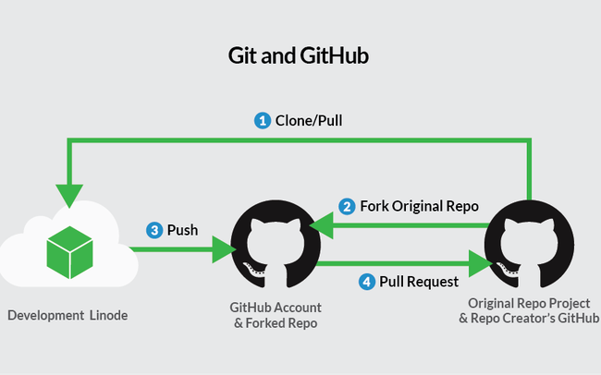
Github
https://github.com/0henri0/web--video-call-by-nodejs-socket-io

Slide 9

Heroku server
https://webrtcbythaicute.herokuapp.com
Text
Text
Concept
Text
Txt
Text
Text

Slide 10
Thank You !

